Slide 1
Gun Trucks of Vietnam
UNCLASSIFIED
2LT Gard
UNCLASSIFIED

Slide 2
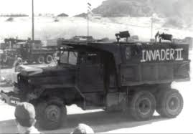
Purpose and Scope
Remain Adaptable and Innovative
History Repeats Itself
UNCLASSIFIED

Slide 3
Outline
Origin
Evolution of the Gun Truck
Gun Truck Doctrine
Effectiveness
Summary
Questions
UNCLASSIFIED

Slide 4
References
http://www.alu.army.mil/alog/issues/JulAug03/gun_trucks.htm - Gun Trucks: A Vietnam Innovation Returns
http://www.alu.army.mil/alog/issues/JanFeb06/gun_trucks.html - Gun Trucks: Genuine Examples of American Ingenuity
Convoy Ambush Case Studies: Volume I - Korea and Vietnam
Author: Richard Killblaine
UNCLASSIFIED

Slide 5
Origin of the Gun Truck
Army’s 8th Transportation Group
HQ at Qui Nhon, Vietnam
Came about due to NVA and Vietcong ambushes along Route 19
An Khe to Pleiku
2 September 1967, Major ambush about 1/2mi long kill zone which destroyed all but 7 vehicles and 7 Americans were KIA after 10 minutes
UNCLASSIFIED

Slide 6
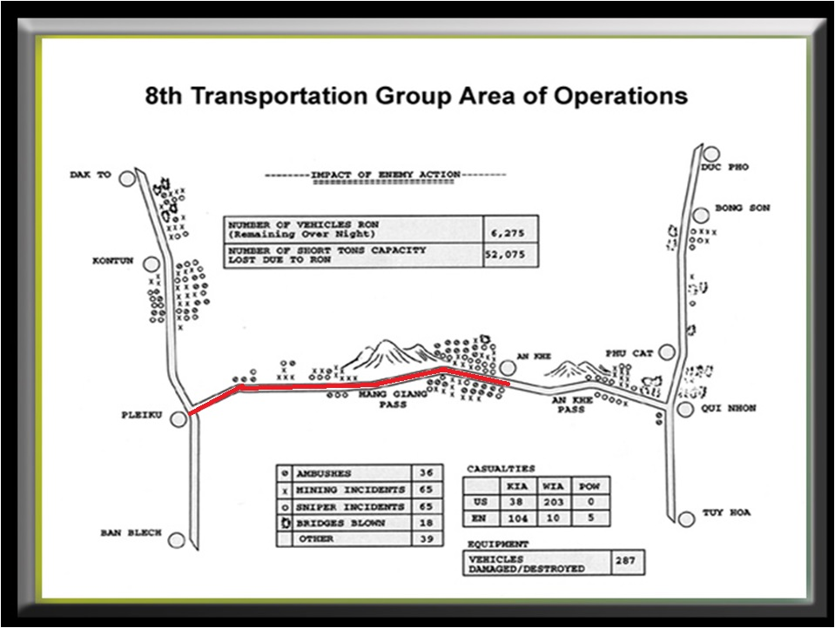

Slide 7
Origins
Convoy security was previously a military police or combat arms job
Jeeps or Task Vehicles with a single machinegun
8th Group recognized importance of dedicated fire-power for convoy protection
Used a 2 1/2 –ton cargo truck and mounted two M60 machineguns on it
Filled sandbag boxes to protect the gunner
UNCLASSIFIED

Slide 8
Evolution of the Gun Truck
2 ½-ton Cargo Trucks
Two M60s with sandbags along sides and floor of truck bed
Eventually replaced sandbags with fabricated steel plates
Lacked sufficient power for maneuvering
Extra weight also caused transmissions and engines to fail quicker
UNCLASSIFIED

Slide 9
Evolution of the Gun Truck
5 –Ton Cargo Truck
Fabricated steel plating
Use of mounted .50-caliber machineguns and “minicannons” along with grenade launchers
Names painted on the sides
i.e. “The Untouchable,” “Outlaw”
Able to better handle the additional weight of the armor
UNCLASSIFIED

Slide 10
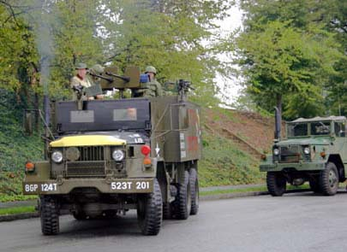
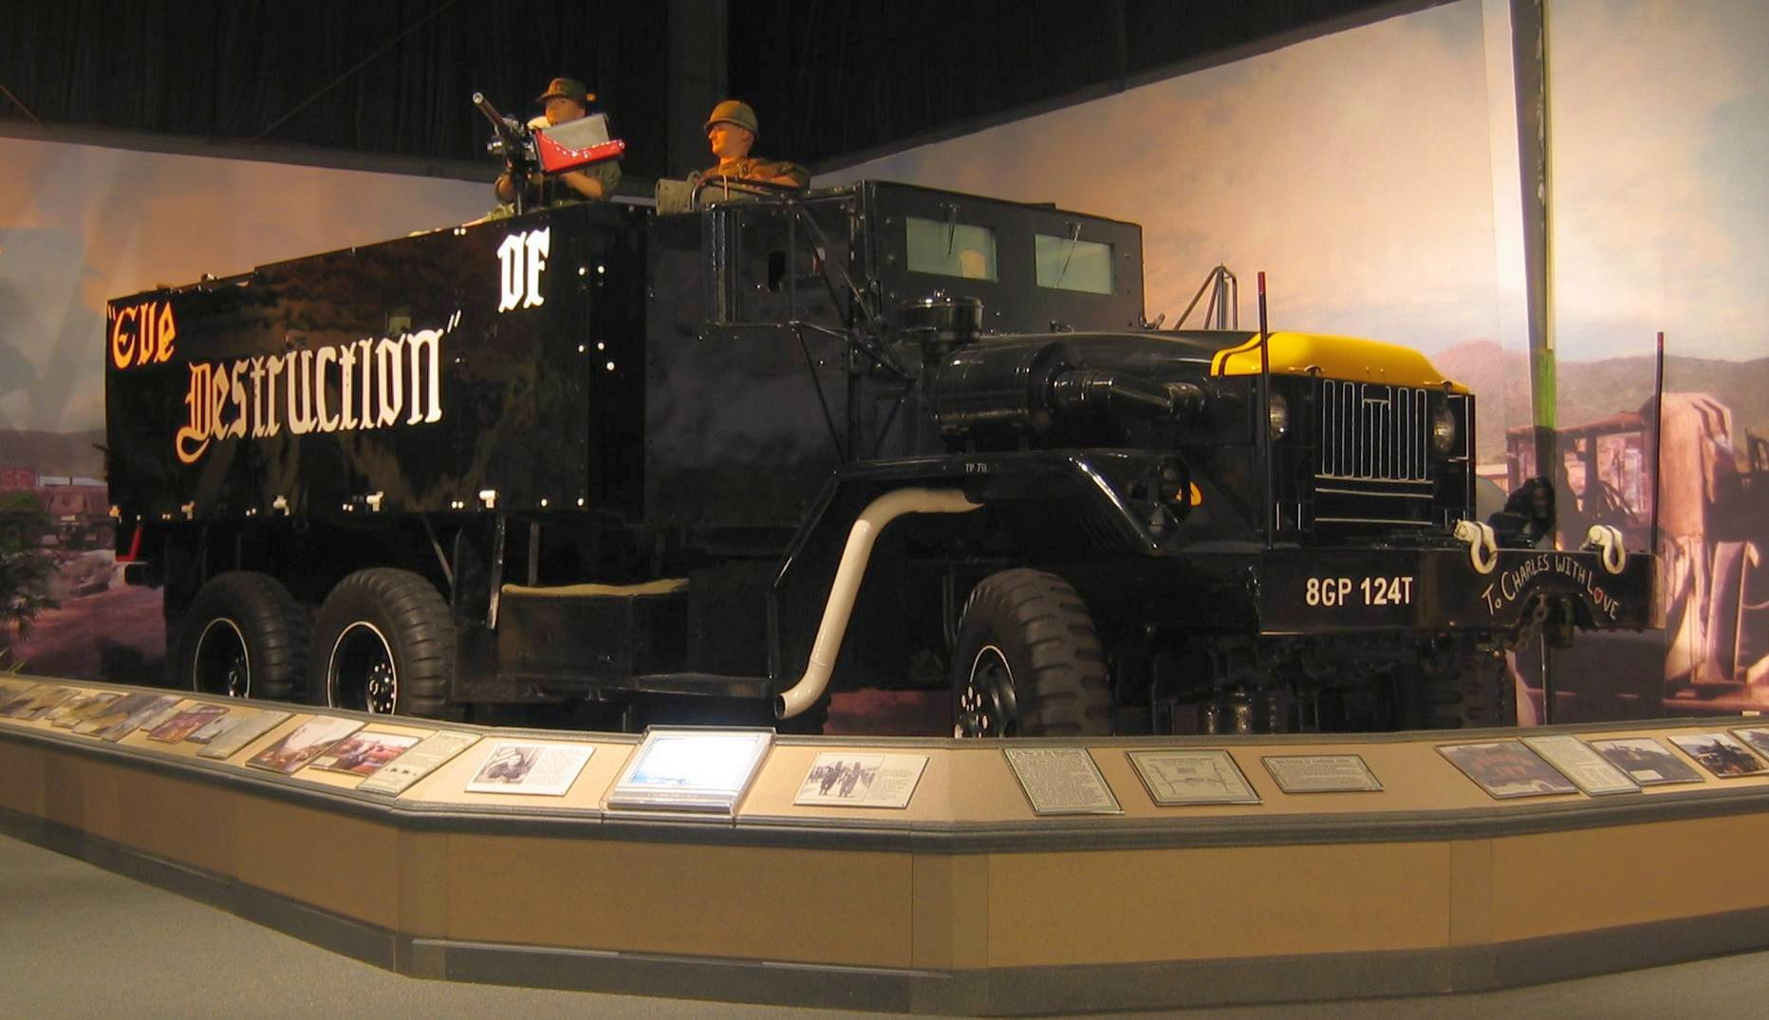
5-Ton
2.5- Ton

Slide 11
Gun Truck Doctrine
Effectively provided convoy security from late 1967 until American forces withdrew in 1973
Estimates total between 300-400 Gun Trucks
Gun truck deployment in convoys usually followed a 1:10 ratio
Allowed for the creation of smaller elements
All convoys had a radio-equipped gun Jeep in lead
Gun Jeep led convoy, a Gun Truck in the middle, and a third Gun Truck was with wrecker in the rear
UNCLASSIFIED

Slide 12
Gun Truck Doctrine
Gun Trucks were trained not to drive into a kill zone to attack the enemy
Provided suppressive fire on the enemy
Security teams from nearest check-points swept the enemy from the area
Attacked the enemy flanks
Provided cover fire for convoy consolidation and reorganization
UNCLASSIFIED

Slide 13
Effectiveness
24 November 1967
70 vehicle convoy attacked by NVA in a 1000m kill-zone
14 trucks lost and 2 American KIAs
41 NVA KIA and 4 captured
December 1967
80 vehicle convoy in a 15 minute battle
13 Enemy KIA
1 American KIA and 6 American Wounded
“These 8th Group truckers are the unsung heroes of this war.”
Lieutenant General William B. Rosson, commander of I Field Force, Vietnam
UNCLASSIFIED

Slide 14
Summary
Gun Trucks developed due to need for improved convoy security
Previously, security tasked to Combat Arms or MP units
Once incorporated, Gun Trucks completely changed convoy doctrine
Gun Trucks gave convoys the ability to push through attacks and complete their mission
UNCLASSIFIED

Slide 15
Questions?
UNCLASSIFIED

